Slide 1


Music Genre Classification
By Bradley Reardon & Salim Haruna

Slide 2


Table of Contents
1
Introduction
2
Dataset Overview
3
Experimental Setup
4
Modeling
5
Results
6
Conclusion

Slide 3
Introduction
1

Slide 4
“Which genre of music is this?”
Blues?
Classical?
Country?
Disco?
Hiphop?
Jazz?
Metal?
Pop?
Reggae?
Rock?
Have you ever heard a song and had difficulty categorizing it into a specific genre of music?
If only you had a...
Music Genre Classifier

Slide 5
“What is the problem?”
Blues?
Classical?
Country?
Disco?
Hiphop?
Jazz?
Metal?
Pop?
Reggae?
Rock?
Music changes very rapidly every year and this makes it hard to classify. Also there has been an increase in mixed genre music which creates a confusion in classifying the genre
Music Genre Classifier

Slide 6
Dataset Overview
2

Slide 7
Dataset
Dataset: music genre classification dataset found on Kaggle.
This dataset contains 27 features (filename, rmse, chromasft, central_spectroid, central_bandwidth, rolloff, zero_cross, and 20 mfcc for the various frequencies within each .wav (Mel frequency, the way in which humans perceive sound))
Label: 10 classes (blues, classical, country, disco, hiphop, jazz, metal, pop, reggae, rock)
1,000 rows, each row representing a single .wav file.

Slide 8
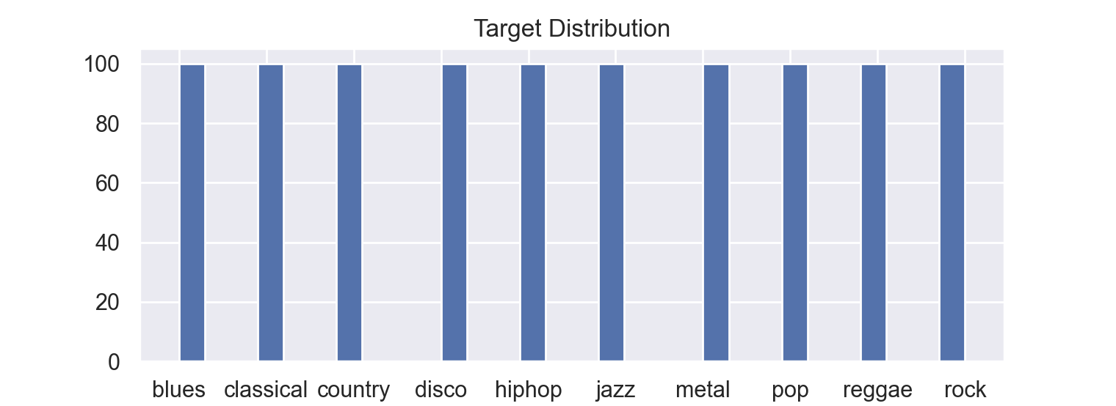
Target Balance

Slide 9
Experimental Setup
3

Slide 10
Data Preprocessing
Test Data
The uploaded mp3 on the GUI is read using pydub
Label Encoding
Target feature is label encoded (0 - 9)
Training Data
Training Data features and observations are read into a dataframe
Feature Extraction
Features are extracted from the .wav file, and the file is observed at a byte level (1 row = 1 byte). Data stored in new dataframe.
.wav Conversion
.mp3 file is converted to .wav to generate the sound waves and signals

Slide 11
Modeling
4

Slide 12
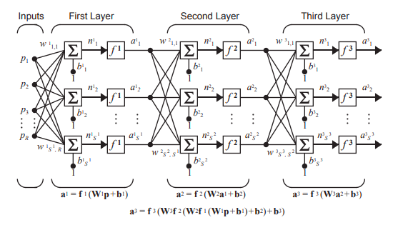
Multilayer Perceptron
Feedforward artificial neural network
Consists of three or more layers:
Input, Hidden Output
Utilizes backpropagation
Supervised learning technique
Benefits:
Can distinguish data that is not linearly separable
Can perform regression or classification

Slide 13
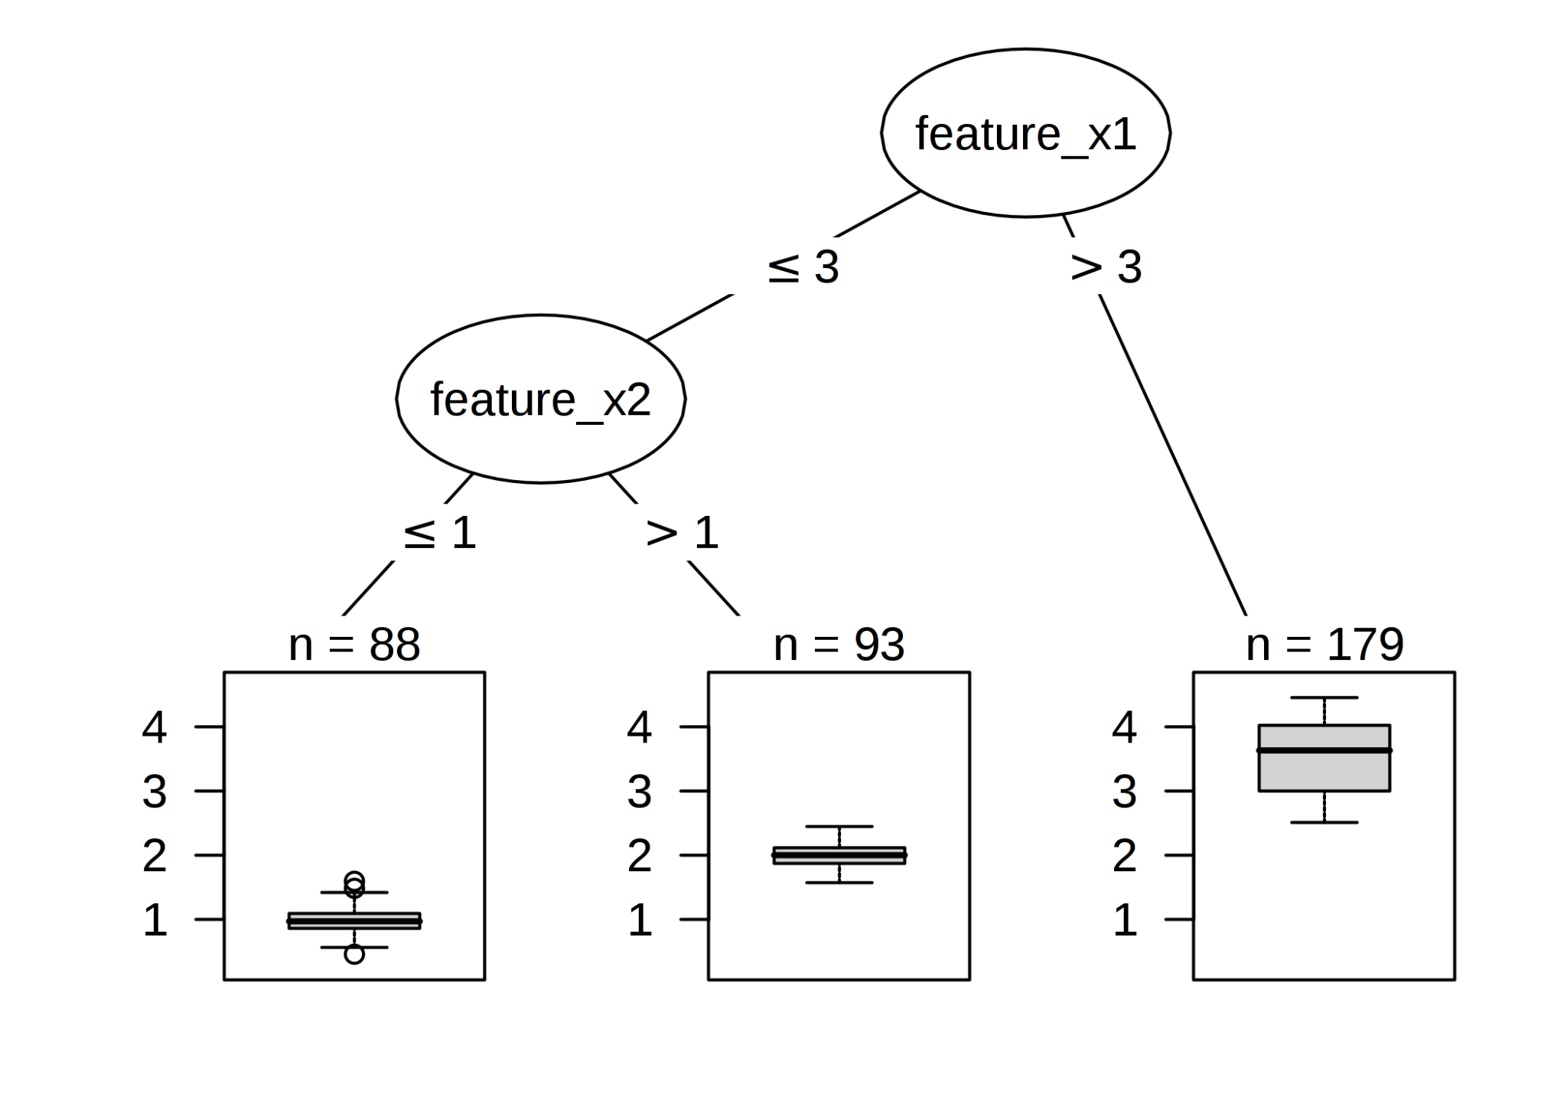
Decision Tree
Consists of a root node and its successor children nodes
Each node is split into binary groups based on a threshold of one of the features in the dataset
Recursive partitioning continuously occurs until a subset of a node all have the same features, in which case they are grouped as a class
Benefits:
Easy to read and interpret
Less data cleaning is required

Slide 14
Modeling
01
Create Network
MLPClassifier(
hidden_layer_sizes=(60,100,60),max_iter=10000,learning_rate='invscaling,solver="adam", activation='tanh', alpha= 0.0001)
Cross-Validation - GridSearchCV
Fit Data
02
Using the NN classifier, train the model on data matrix (X) and target (y)
Classify
03
Predict the uploaded .mp3 data using the multi-layer perceptron classifier
Result
04
Display the classification report, the audio Monophonic Waveform, and the classified music genre.

Slide 15
Results
5

Slide 16
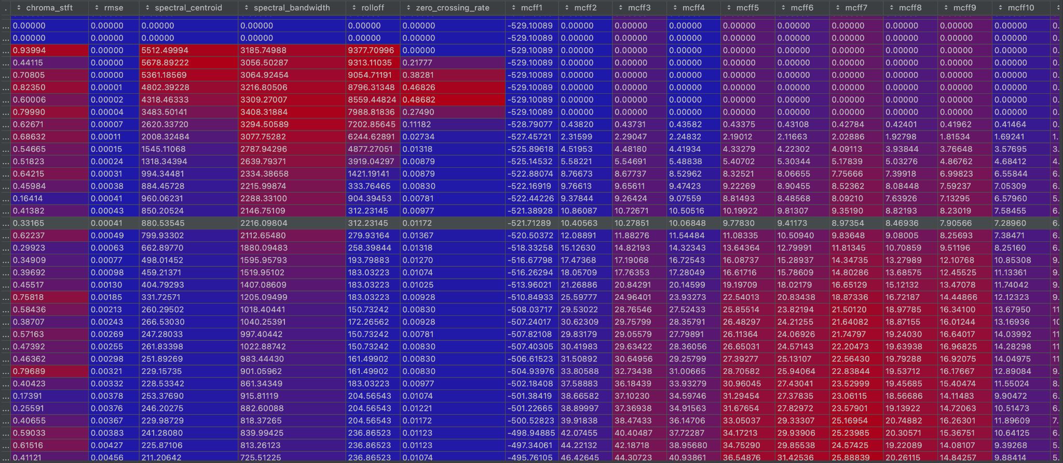
.mp3 file to .wav conversion

Slide 17
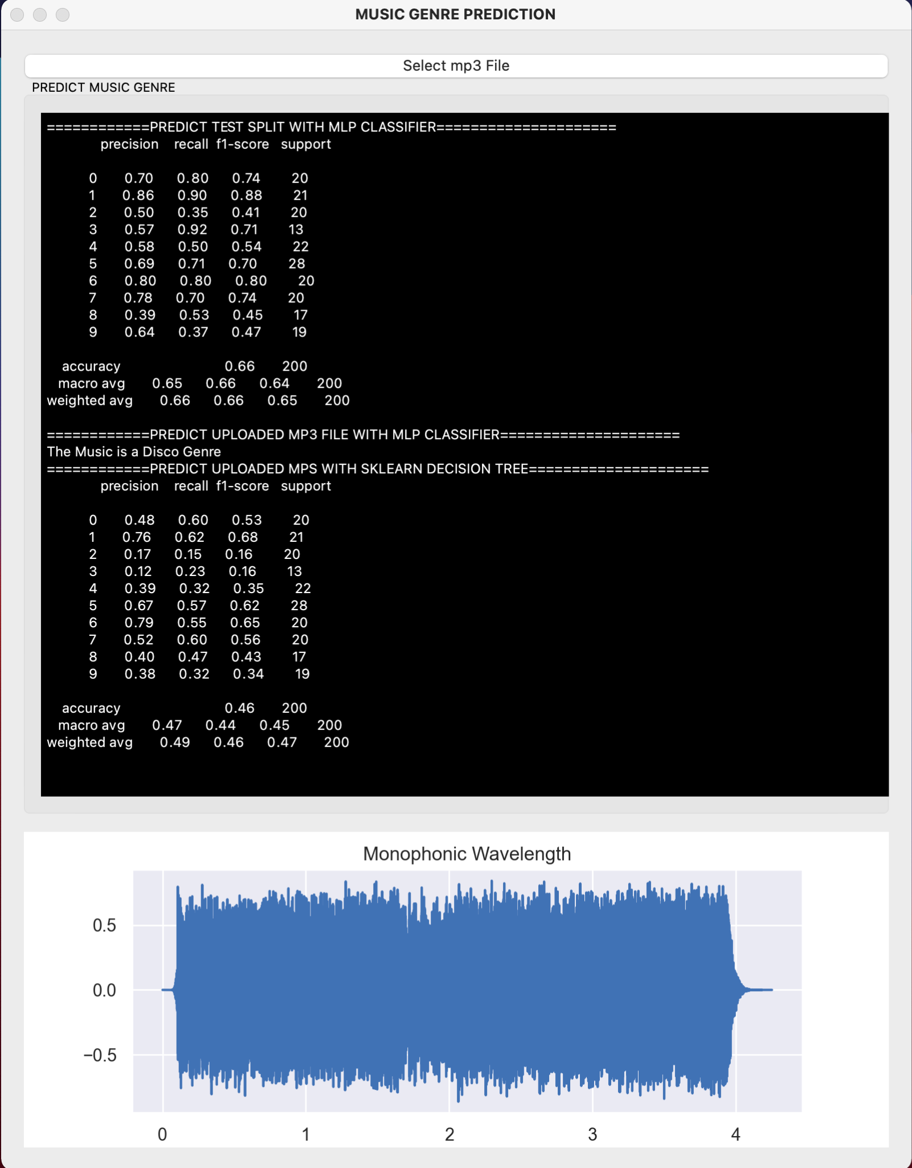


Outcome
MLPClassifier
Decision Tree
Accuracy Score: ~0.65
Max F1-score variance: ~0.40
Consistently outperformed decision tree model
Accuracy Score: ~0.45
Max F1-score variance: ~0.50

Slide 18
Conclusion
6

Slide 19
Conclusion
Surprised the neural network outperformed a traditional model given the small dataset size
MLPClassifier consistently outperformed the DecisionTreeClassifier
Overview
Difficulties
Songs might not always fit into one genre
High single-label precision is difficult to achieve
Caveats
Training data limited to 10 core genres - ideal if training data consisted of larger array of genres
Single-labeled classification is difficult to work with - interested to see how well the models would perform on multi-labeled data

Slide 20








Potential Clients
Soundcloud
Bandcamp
Tidal
Pandora
Music Genre Classifier
Spotify
Apple Music
Amazon Music Unlimited
Youtube Music

Slide 21
Citations
Abirami , S., & Chitra, P. (n.d.). Multilayer Perceptron. Multilayer Perceptron - an overview | ScienceDirect Topics. https://www.sciencedirect.com/topics/computer-science/multilayer-perceptron.
GridSearchCV. scikit. (n.d.). https://scikit-learn.org/stable/modules/generated/sklearn.model_selection.GridSearchCV.html.
Jiaaro. (n.d.). jiaaro/pydub. GitHub. https://github.com/jiaaro/pydub.
librosa. (n.d.). https://librosa.org/doc/latest/index.html.
MLPClassifier. scikit. (n.d.). https://scikit-learn.org/stable/modules/generated/sklearn.neural_network.MLPClassifier.html.
Natarajan, H. (2020, November 3). Music Genre Classification. Kaggle. https://www.kaggle.com/harish24/music-genre-classification.

Slide 22
Thank You

